Slide 1
Transition diagrams
Bayesian Data analysis

Slide 2

Transition probability
$$p_{ij}=q_{j}α_{ij}, i≠j$$

Slide 3
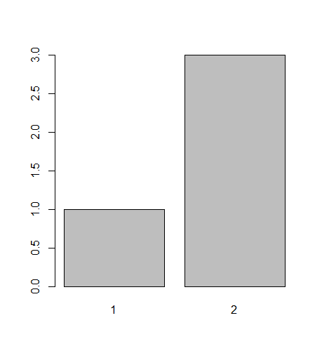
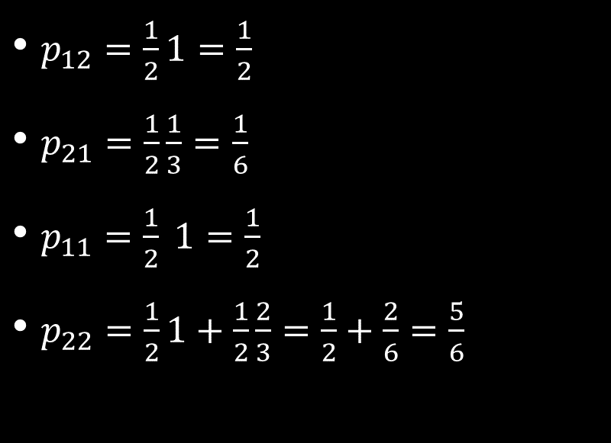
Lets do the calculation for a 2 state
$p_{12}=\frac{1}{2}1=\frac{1}{2}$
$p_{21}=\frac{1}{2}\frac{1}{3}=\frac{1}{6}$
$p_{11}=\frac{1}{2} 1=\frac{1}{2}$
$p_{22}=\frac{1}{2}1+\frac{1}{2}\frac{2}{3}=\frac{1}{2}+\frac{2}{6}=\frac{5}{6}$

Slide 4




$$p_{12}$$
1
2
$$p_{11}$$
$$p_{22}$$
$$p_{21 }$$

Slide 5

P matrix
$$P=\left(\begin{matrix}p_{11} & p_{12} \\ p_{21} & p_{22}\end{matrix}\right)$$
$$P=\left(\begin{matrix}\frac{1}{2} & \frac{1}{2} \\ \frac{1}{6} & \frac{5}{6}\end{matrix}\right)$$

Slide 6


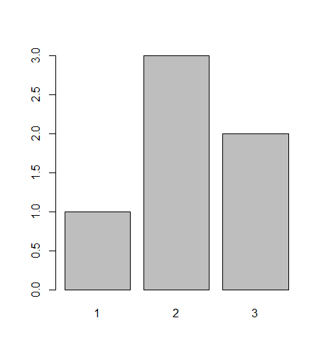
Uniform proposal
draw the transitional diagram and Find P

